Slide 1
E-Commerce Sales & Profitability Analysis
"Our business needs to understand what
drives revenue and where we're losing money.
Key Question: What factors impact
profitability across categories, regions
and customer segments?"

Slide 2
The Data
- 800 orders across 11 months (Jan-Nov 2023)
- 4 categories: Technology, Furniture,
Office Supplies, Clothing
- 4 regions: North, South, East, West
- 147 unique customers
- Tools: Python, SQL, Tableau

Slide 3
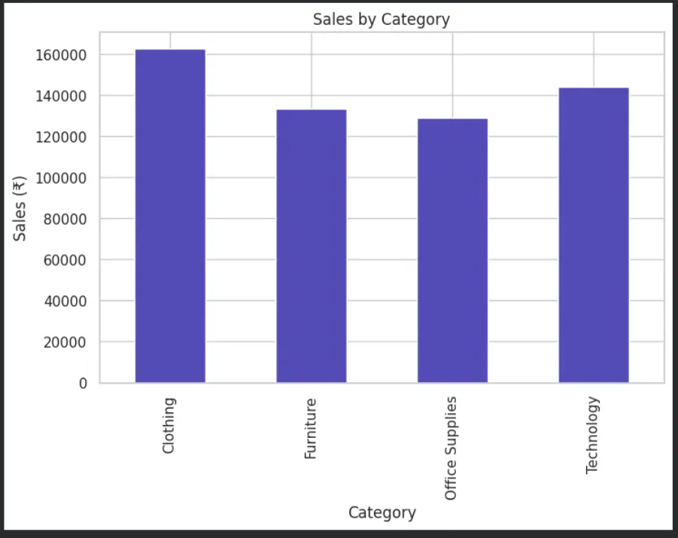
Clothing Leads Revenue, But Losses Are High
- Clothing is the top category (₹1,62,627)
- BUT 34.4% of ALL orders are loss-making
- This is a major red flag for profitability

Slide 4
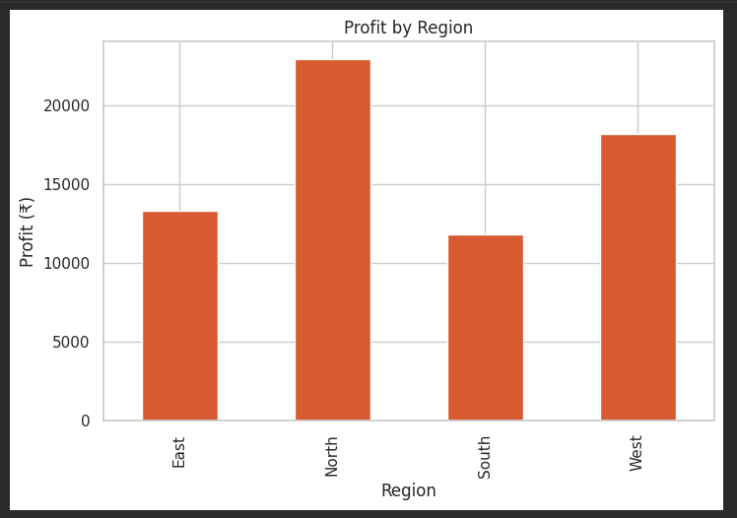
North Region Outperforms on Profitability
- North region generates highest profit (₹23K)
- Discount level shows almost NO correlation with profit (-0.03)
- Discounting isn't the cause of losses

Slide 5
Recommendations
1. Investigate 34% loss-making orders —
likely a pricing/cost issue
2. Replicate North's profit strategy
in South region
3. Focus marketing on Corporate segment
4. Build automated dashboards for
ongoing monitoring
Live Dashboard:
https://public.tableau.com/app/profile/prajwal.nh/viz/dashboard_v2025_3/EcommerceCapstoneDashboard

